Slide 1

Ransomware study

Slide 2
How does a ransomware attack work?
[attacker→victim] The attacker generates a key pair and places the corresponding public key in the malware. The malware is released.
[victim→attacker] To carry out the cryptoviral extortion attack, the malware generates a random symmetric key and encrypts the victim's data with it. It uses the public key in the malware to encrypt the symmetric key. This is known as hybrid encryption and it results in a small asymmetric ciphertext as well as the symmetric ciphertext of the victim's data. It zeroes he symmetric key and the original plaintext data to prevent recovery. It puts up a message to the user that includes the asymmetric ciphertext and how to pay the ransom. The victim sends the asymmetric ciphertext and e-money to the attacker.
[attacker→victim] The attacker receives the payment, deciphers the asymmetric ciphertext with the attacker's private key, and sends the symmetric key to the victim. The victim deciphers the encrypted data with the needed symmetric key thereby completing the cryptovirology attack.

Slide 3
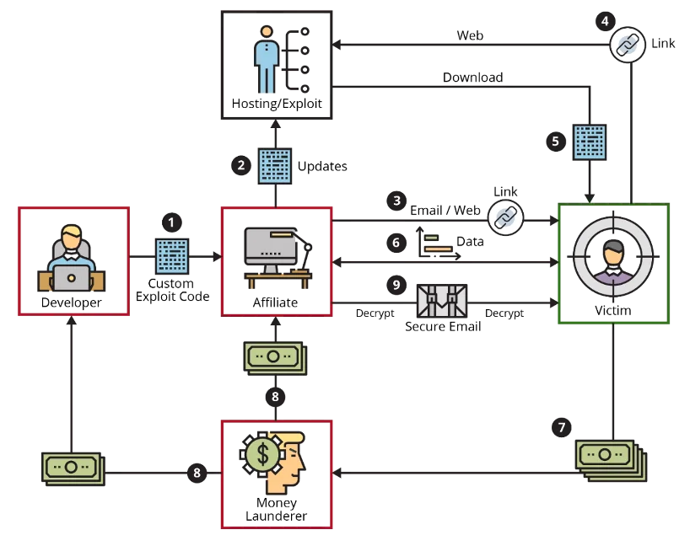
Ransomware-as-a-service

Slide 4
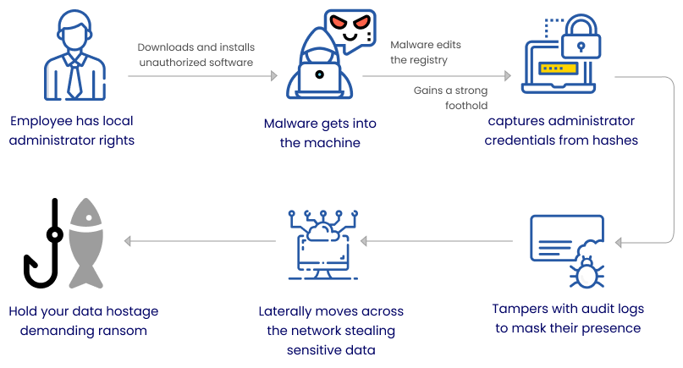
What our work will be targeting?

Slide 5
Darkside Ransomware (V. 2.1.2.3)
Ransomware used in the Colonial Pipeline attack
Sold as a RaaS model
Two different kinds:
DarkSide v2.1
53kb
Voice Over IP feature
DarkSide v1.0 – 59.5kb
Uses Windows PowerShell to delete shadow volume copies on compromised systems

Slide 6
Capabilities of Darkside
Encrypt all files using a combination of Salsa20 and RSA-1024
Checking the system language and avoiding encrypting Russian language machines, wiping Recycle Bin, ignoring specific files, directories, and file extensions, killing specific processes, deleting specific services
Empty the Recycle Bins
Uninstall services
Delete shadow copies
Terminate processes
Encrypt local disks
Encrypt network shares

Slide 7
How darkside works
The files are encrypted using the custom Salsa20 implementation, with the Salsa20 matrix being encrypted by the public RSA key hard-coded in the binary.
The process generates a random Salsa20 matrix using the RDRAND and RDSEED instructions, as opposed to earlier versions that use the RtlRandomEx function.
The entire breakdown of the ransomware is present at https://cybergeeks.tech/a-step-by-step-analysis-of-a-new-version-of-darkside-ransomware/

Slide 8
Ransomware detection - File Server Resource Manager
FSRM stands for File Server Resource Manager, which is a built-in feature in Windows Server that allows system administrators to manage and monitor the use of storage resources on a file server.
FSRM can be used to monitor file activity and detect suspicious behavior, such as a large number of files being modified or deleted in a short period of time. This can help administrators detect and respond to ransomware attacks in real-time, before they can cause significant damage.
A lot of false positives but effective in most cases.
Notes:
Other than obvious tools such as nessus.

Slide 9
Source
https://www.reddit.com/r/Malware/comments/qhse7t/list_of_ransomware_groups_and_their_pr_pages_2021/
https://malpedia.caad.fkie.fraunhofer.de/ - if you have access
https://malshare.com/ - this one is great
https://malware.one/
https://beta.virusbay.io/login - great for requesting samples
https://vxug.fakedoma.in/

